Slide 1
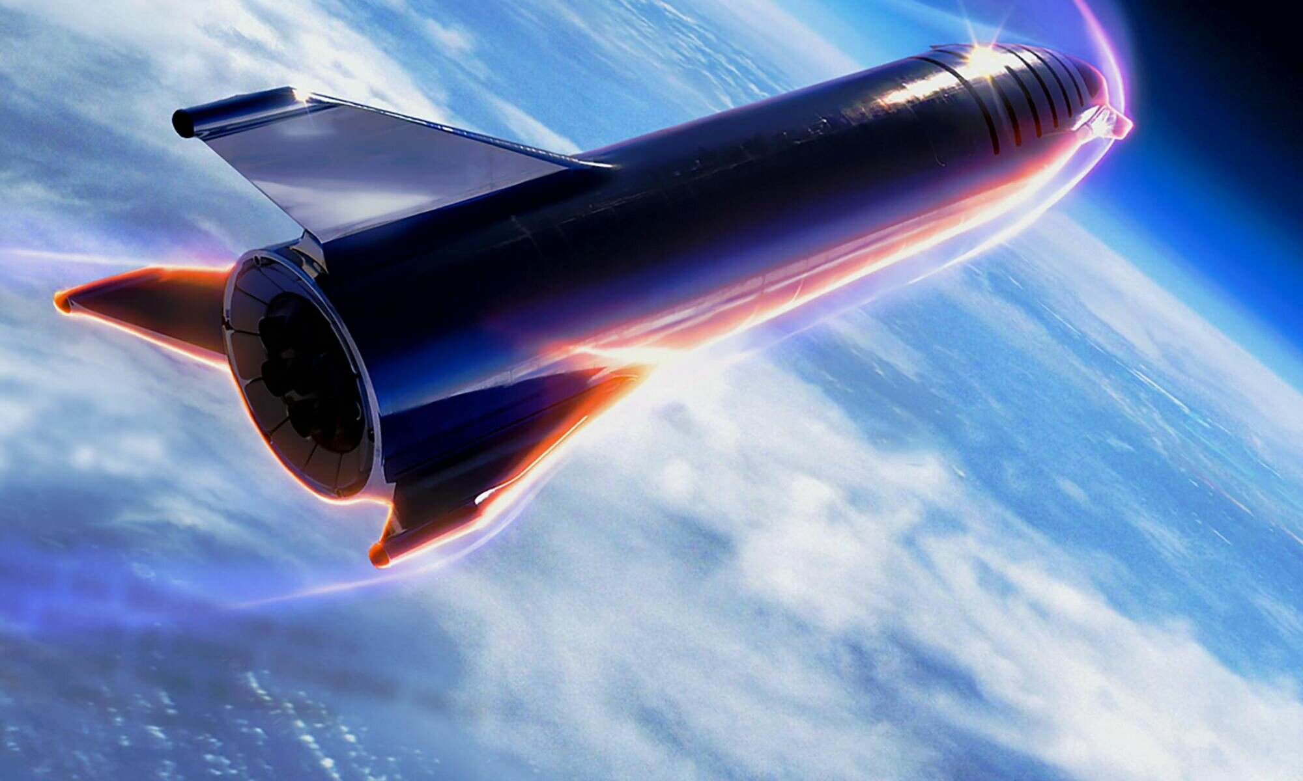
SpaceX
Capstone Project
Professional Certificate IBM Python for Data Science
VASA PURNA PRANEETH 30th June 2024

Slide 2

Outline
Executive Summary Introduction Methodology Results
Conclusion

Slide 3



Executive Summary
Data Collection using API
Data Collection using Web Scraping Data Wrangling
Exploratory Data Analysis using SQL Exploratory Data Analysis and Visualization Visual Analytics with Folium
Machine learning Prediction
Methodologies Summary
Exploratory Data Analysis result Dash in Screenshots
Predictive Analytic result
Results Summary

Slide 4



Introduction
Target
The goal of this project is to design a Machine learning pipeline to predict if the first stage will land successfully.
Context
SpaceX claims that Falcon 9 rocket launch cost 62 million; Other providers cost 165 million dollars. Much of the savings are because Space X can reuse the first stage. If we can determine if the first stage will land, we can determine the cost of the launch.
Problems
Which factor can determine if the rocket will land successfully?
Which Interaction between various features can determine the success rate of a successful landing?
What conditions need to be ensured for a successful landing?

Slide 5
Data Collection using API
Data Collection using Web Scraping Data Wrangling
Exploratory Data Analysis using SQL Exploratory Data Analysis and Visualization Visual Analytics with Folium
Machine learning Prediction
Methodology

Slide 6
The data was collected using various methods
Data collection was done using get request to the SpaceX API.
Next, the response content as a Json using .json() function call was decoded
and turned into a pandas data frame using .json_normalize().
Data were cleaned and checked for missing values and fill in missing values where necessary.
In addition, we performed web scraping from Wikipedia for Falcon 9 launch
records with BeautifulSoup.
The objective was to extract the launch records as an HTML table, parse the table and convert it to a pandas data frame for future analysis.

Slide 7


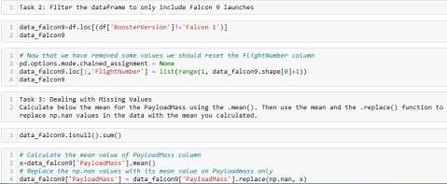
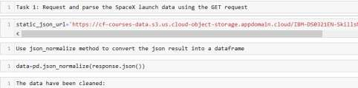
Data Collection – SpaceX API
We used the get request to the SpaceX API to collect data:
Clean the requested data and do some basic data wrangling and formatting.
GIT HUB LINK : Data Collection

Slide 8


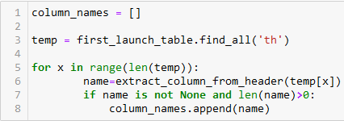
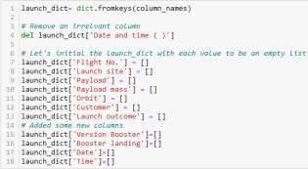

Data Collection Scraping
We applied web scrapping to web scrap Falcon 9 launch records with BeautifulSoup
We parsed the table and converted it into a pandas data frame.
GIT HUB LINK : Data Collection Scraping

Slide 9
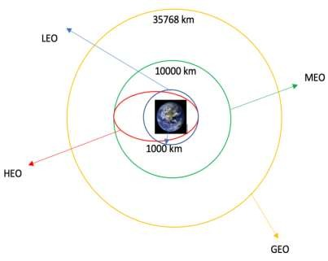
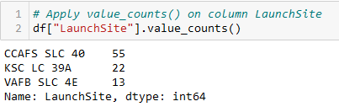
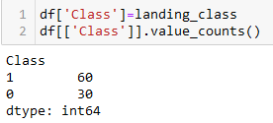
Data Wrangling
We performed exploratory data analysis and determined the training labels.
We calculated the number of launches at each site, and the
number and occurrence of each orbit
We created a landing outcome label from the outcome column and exported the results to CSV.
GIT HUB LINK : Data Wrangling
CAPE CANAVERAL SPACE LAUNCH COMPLEX 40 KENNEDY SPACE CENTER LAUNCH COMPLEX 39A
VANDENBERG AIR FORCE BASE SPACE LAUNCH COMPLEX 4E
9

Slide 10
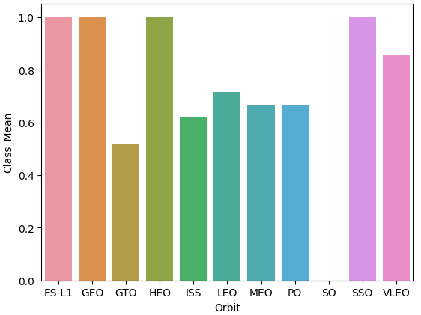
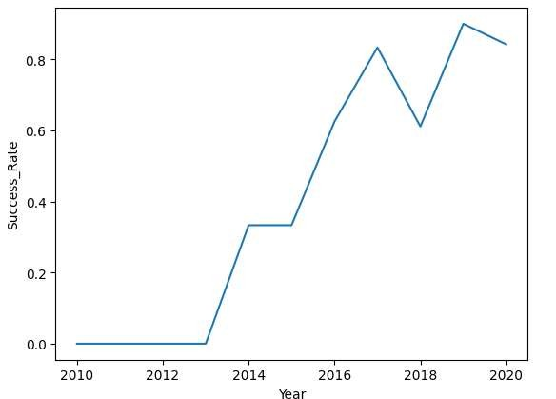
EDA with Data Visualization
We explored the data by visualizing the relationship between flight number and launch Site, payload and launch
site, the success rate of each orbit type, flight number and orbit type, and the launch success yearly trend.
GIT HUB LINK : EDA With Data Visualization

Slide 11

EDA with SQL
We loaded the SpaceX dataset into a PostgreSQL database without leaving the jupyter notebook.
We applied EDA with SQL to get insight from the data. We wrote queries to find out for instance:
The names of unique launch sites in the space mission.
The total payload mass carried by boosters launched by NASA (CRS)
The average payload mass carried by booster version F9 v1.1
The total number of successful and failure mission outcomes
The failed landing outcomes in drone ship, their booster version and launch site names.
GIT HUB LINK : EDA with SQL

Slide 12
Build an Interactive Map with Folium
We marked all launch sites and added map objects such as markers, circles, and lines to mark the success or failure of launches for each site on the folium map.
We assigned the feature launch outcomes (failure or success) to classes 0 and 1.
0 for failure and 1 for success.
Using the color-labeled marker clusters, we identified which launch sites have a relatively high success rate.
We calculated the distances between a launch site to its proximities. We answered some questions, for instance:
Are launch sites near railways, highways, and coastlines?
Do launch sites keep a certain distance away from cities?

Slide 13
Built a Dashboard with Plotly Dash
An interactive dashboard with Plotly dash was built
We plotted pie charts showing the total launches by specific sites
We plotted a scatter graph showing the relationship between Outcome and Payload Mass (Kg) for
the different booster versions.

Slide 14
Predictive Analysis Classification
Data have been loaded using NumPy and pandas, transformed, and split into training and testing.
We built different machine learning models and tuned different hyperparameters using
GridSearchCV.
We used accuracy as the metric for our model and improved the model using feature engineering and algorithm tuning.
We found the best performing classification model.
GIT HUB LINK : Predictive Analysis

Slide 15

Results
EDA results
Interactive Analytics demo in screenshots
Predictive analysis results

Slide 16
Insights from Exploratory data analysis

Slide 17
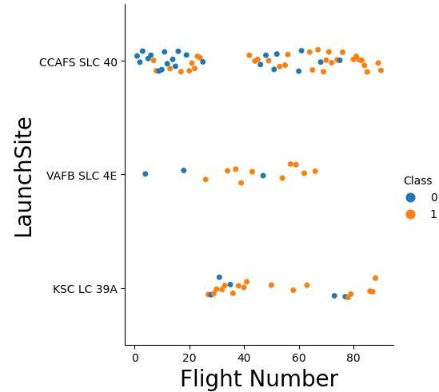
Flight Number vs. Launch Site
From this graph, we can deduce that CCAFS SLC 40 was the most used launch site, the progressively rare number of blue dots (failure) suggest a progressive improvement over time

Slide 18
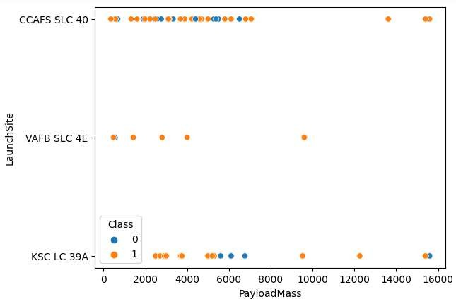
Payload vs Launch Site
With a closer look at the graph, we can
see that:
payload mass >8k kg has a high success rate in all launch sites,
2k<Payload mass<8k Kg. We have a significant concentration of failure
VAFB-SLC launch site, there are no rockets launched for heavy payload mass(greater than 10000)

Slide 19
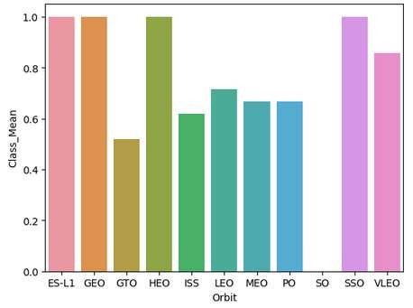
Success Rate vs Orbit Type
ES-L1, GEO, HEO, SSO,
and VLEO had the most success rate, as we can see on this graph

Slide 20
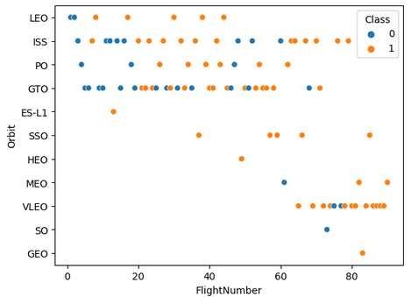
Flight Number vs Orbit Type
We observe that 51% of the 27 GTO
Flight numbers have been successful
LEO 71.5%
ISS 62%
VLEO 86%
ES-L1 and SSO performed well ( 100% successful ) but a fewer number of launches were committed to reach those orbits

Slide 21
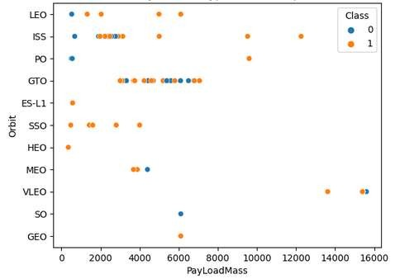
Payload vs Orbit Type
Successful landings of heavy payloads (more than 6000Kg) are more for LEO, ISS, and GTO orbits
A large part of the payload weight per launch was less than 6000Kg

Slide 22
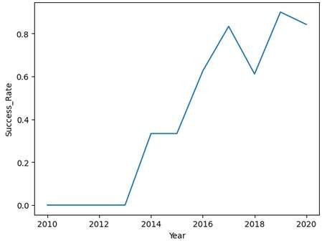
Launch Success Yearly Trend
Since 2013, the success rate kept on increasing till 2020, as we can see from this plot

Slide 23

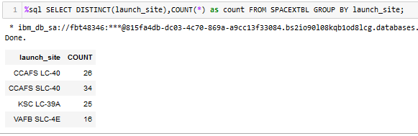
the key word DISTINCT to show only unique launch sites
All Launch Site Names

Slide 24
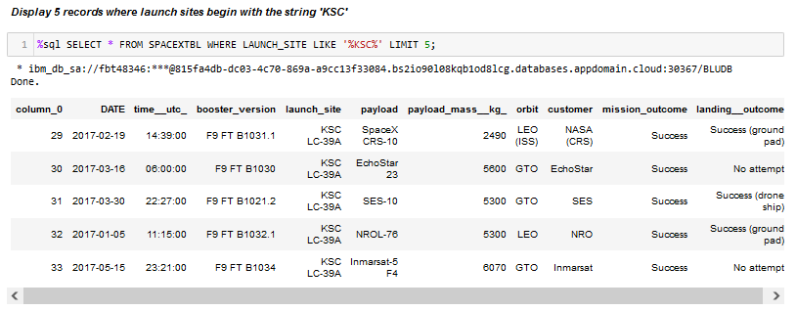
We used the query above to see only 5 of all site ‘KSC’
Launch Site Names Begin with KSC

Slide 25
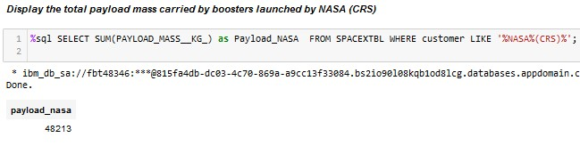
Total Payload carried by boosters for NASA (CRS) is 48213.
Total Payload Mass

Slide 26
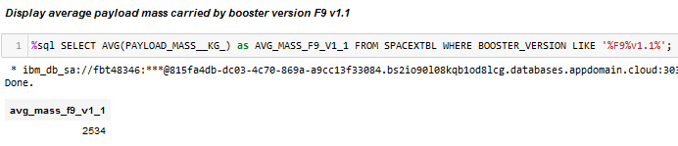
Calculated the average payload mass carried by booster F9 v1.1 as 2534
Average Payload Mass by F9 v1.1

Slide 27
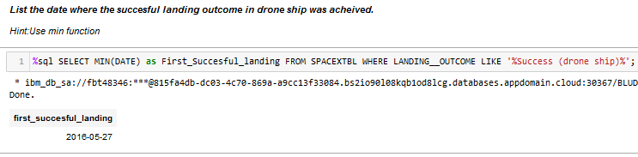
We observed that the date of the first successful landing outcome in the drone ship was 27th May 2016
First Successful Ground Landing Date

Slide 28
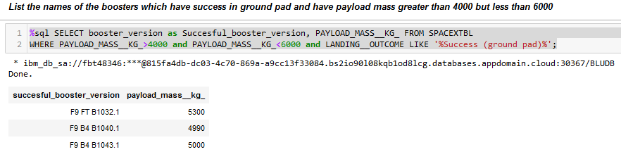
Using WHERE clause to filter successfully landed booster on ship pad and applied AND condition
Successful Drone Ship Landing with Payload between 4000 and 6000

Slide 29
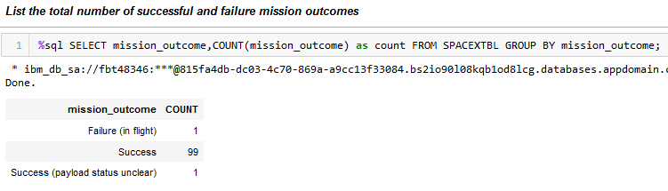
Total Number of Successful and Failure Mission Outcomes

Slide 30
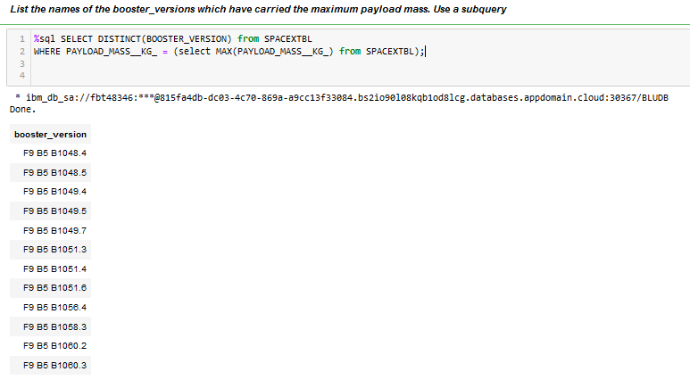
Determined the booster that has carried the maximum payload using a
subquery in the WHERE clause and the MAX() function
Boosters Carried Maximum Payload

Slide 31
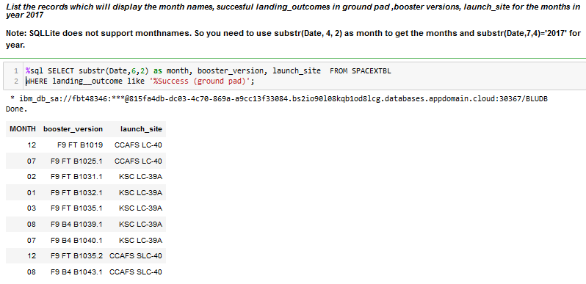
Using WHERE clause with LIKE, AND, and BETWEEN conditions to filter for failed landing outcomes in drone ships, their booster versions, and launch site names for the year 2015
2015 Launch Records

Slide 32
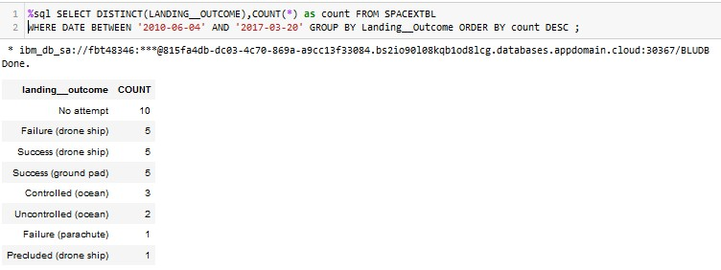
We selected Landing outcomes and the COUNT of landing outcomes from the data and used the WHERE clause to filter for landing outcomes BETWEEN 2010-06-04 to 2010-03-20.
We applied the GROUP BY clause to group the landing outcomes and the ORDER BY clause to order the grouped landing outcome in descending order.
Rank Landing Outcomes Between 2010 and 2017

Slide 33

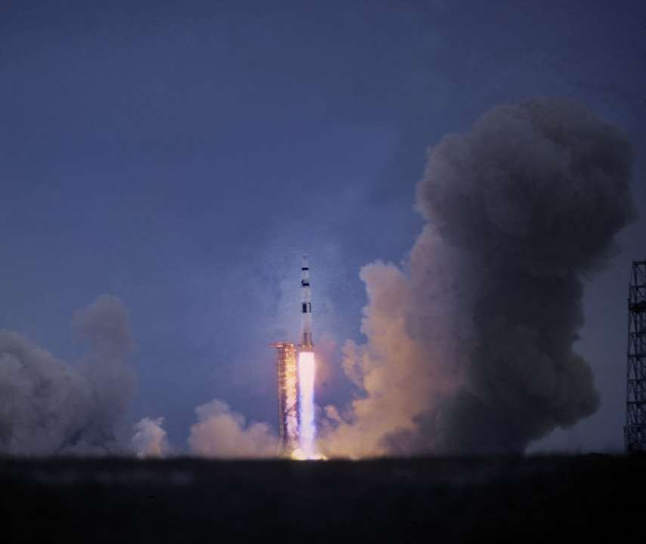

Launch Sites with Folium

Slide 34
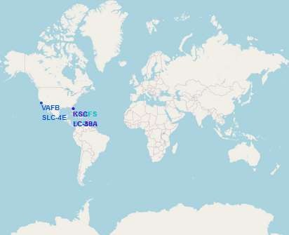
All Launch sites in the global map
As we can see Space X launch sites are in USA, Florida and California

Slide 35
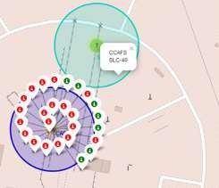
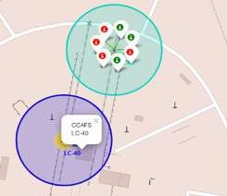
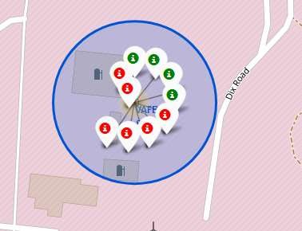
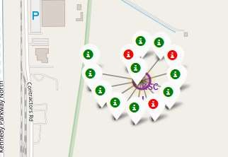
Markers showing launch sites with color labels
Florida Launch Sites
California Launch Site
Florida Launch Sites

Slide 36
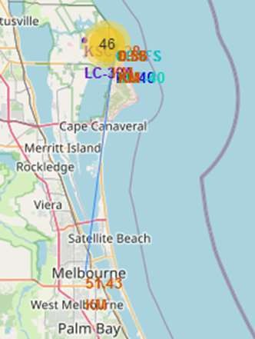
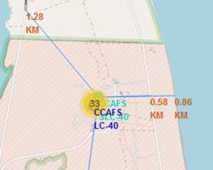
Launch Site Distance to Landmarks
Are launch sites near
railways? 1.28km
Are launch sites near highways? 30km
Are launch sites near the
coastline? 0.86km
Do launch sites keep a certain distance away from cities? 51 km

Slide 37


Build a Dashboard with Plotly Dash

Slide 38

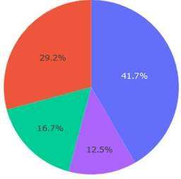
KSC LC-39A had the most successful of all the sites
Total Success Launches By all sites

Slide 39

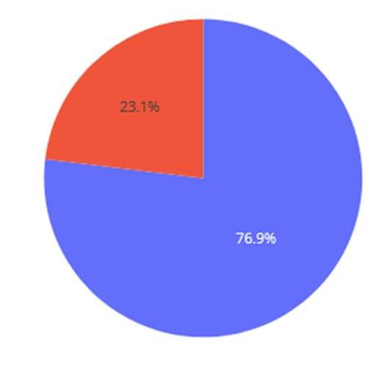
KSC LC-39A was the most successful of all the sites it achieved a 76.9% success rate while getting a 23.1% failure rate
Launch Site with the highest launch success ratio

Slide 40
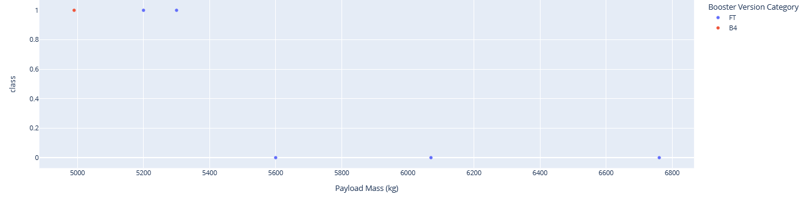
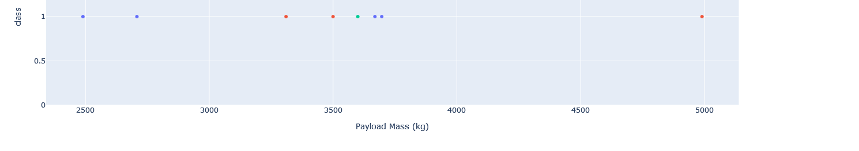

Scatter plot
Payload vs. Launch Outcome for all sites
Heavy Weighted Payload 4000 -10000 Kg
Low Weighted Payload 0-4000 Kg

Slide 41


Predictive Analysis Classification

Slide 42
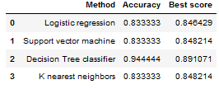
Classification Accuracy
The decision tree classifier is the model with the highest classification accuracy

Slide 43
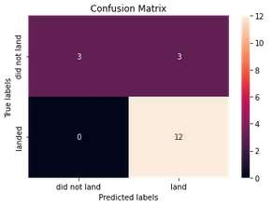
Confusion Matrix
The confusion matrix shows that the classifier can distinguish between the different classes.
The major problem is the false positives, in this project, the unsuccessful landing is marked as a successful landing by the classifier

Slide 44
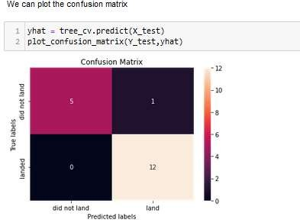
Prediction tree classifier performs best
Prediction tree classifier performs best in distinguishing false positives

Slide 45
Conclusions
Seen these data, we can conclude that
The Decision tree classifier is the best machine learning algorithm for this task.
Launch success rate started to increase in 2013 till 2020
Orbits ES-L1, GEO, HEO, SSO, and VLEO had the most success rate
KSC LC-39A had the most successful launches of any sites

Slide 46
Thank you

